Slide 1
Land cover map
Jan 31, 2018

Slide 2
Land Cover Classification (for soy)

Slide 3
Validation with commercial high resolution satellite imagery
Requested quote from Satellite Imaging Corp (QuickBird) – but was directed to PlanetLabs
Images searchable on LandInfo:
GeoEye-1
WorldView-1, to -4
IKONOS
SPOT 1- 7
RapidEye
PlanetScope/Dove (Planet Labs)
QuickBird (Planet Labs)
Planet Labs satellites
PlanetScope (Planet Labs, 3m)
QuickBird (Planet Labs, 5m) – requested QuickBird quote from Satellite Imaging Corp, redirected to PlanetLabs
Prices:
SPOT 6: $2.38/km2 with a minimum order of 100km2.
RapidEye: $1.28/km2 wit minimum order of $5,000
WorldView2: $12.25/km2

Slide 4
Land Cover Classification (center pivot)

Slide 5
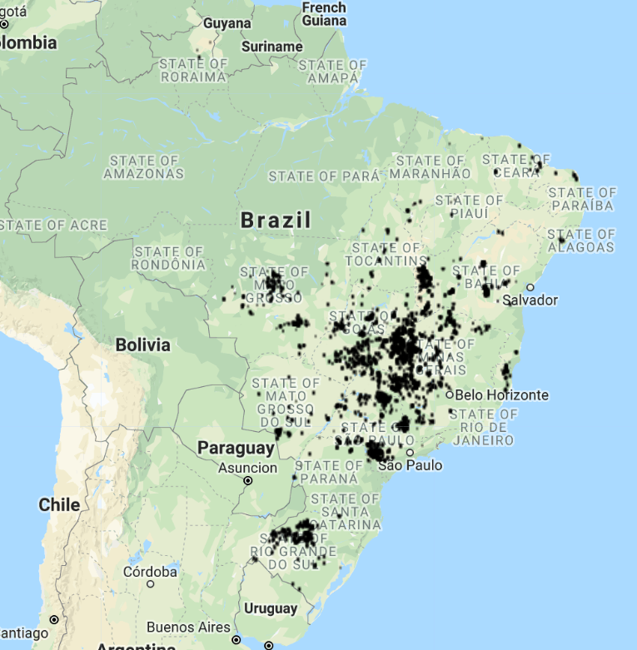
Center Pivot Edge detection method
Set up accuracy assessment/method tuning
Randomly select 10 center pivot locations in 2014
Take 2m radius circle around the randomly selected center pivot
Do reduceToVector (computationally intensive!)
Check overlap/nonoverlap of centroids with reported 2014 center pivot depending on:
Kernel size(s)
Landsat 8 day vs 32 day
Date of Landsat image
Landsat image edge cleaning method
Location in Brazil
2014 reported center pivot
In GEE: LandCover/Center Pivot Classification

Slide 6
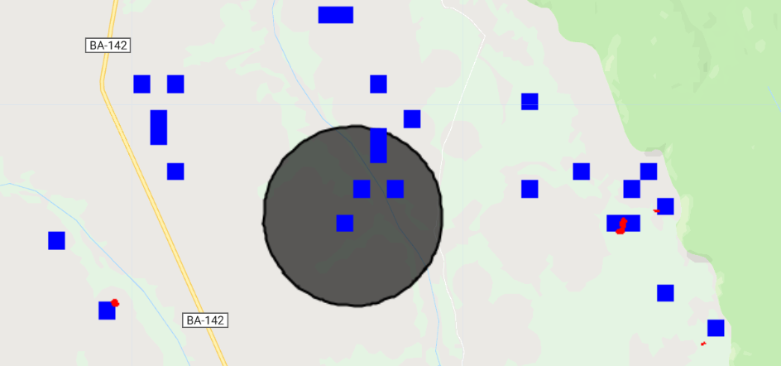
reduceToVectors() and scaling notes
The number of detected CP depends on the scale used during reduceToVectors()
The ability to ‘see’ the red detected image pixels also depends on the scale; did reproject() to 500m to see dots that didn’t appear at 30m
For the same center pivot image, when add area of detected center pivot at 30m scale, get area of zero; at 500m scale, get area of 1km2. why?
NOTE that because I’m using a temporal composite, the image.projection().nominalScale() is 110 km/pixel!
Why do the result of reduceToVectors() and reduceRegion() change based on the scale used?
Why do the red dots disappear from Map.addLayer() at low scales (i.e. at 493m, it disappears but at 495m it’s still there). Similarly, at 494m the reduceregion() area is zero; at 495m it’s about 1km2
Blue = detected CP pixels, reprojected to 500m scale
Red = ‘original’ detected CP pixels (not reprojected)
Cirlce: = 2km buffer around randomly chosen reported CP.
Similarly, no CPs were ‘detected’ at 30m reduceToVectors, but four were detected at 500m reduceToVectors
In GEE: LandCover/Center Pivot Classification

Slide 7
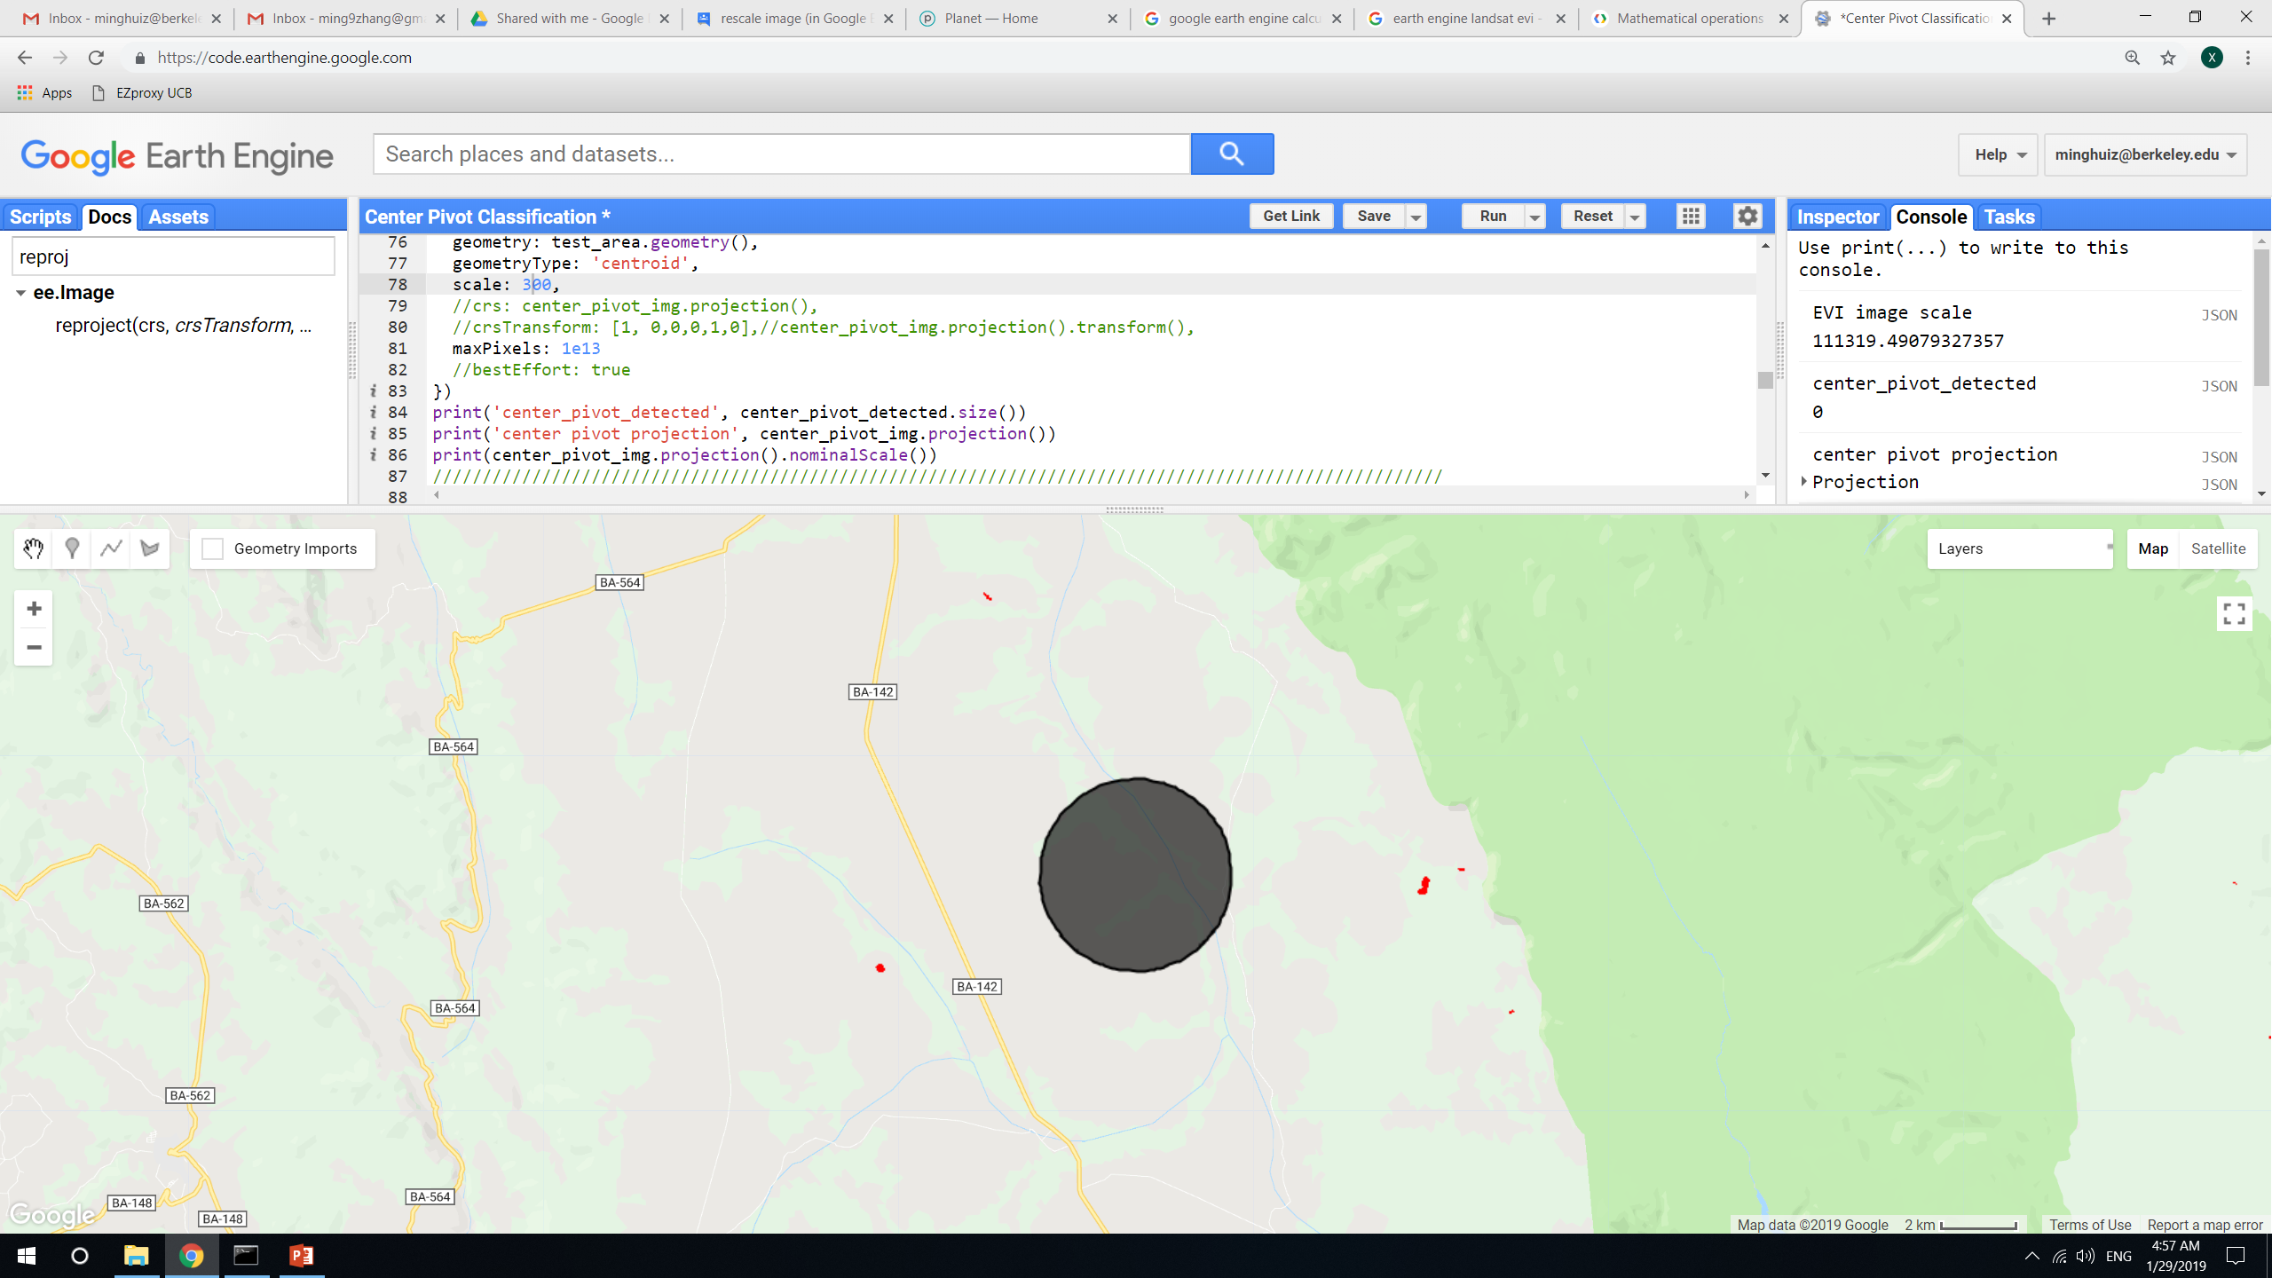
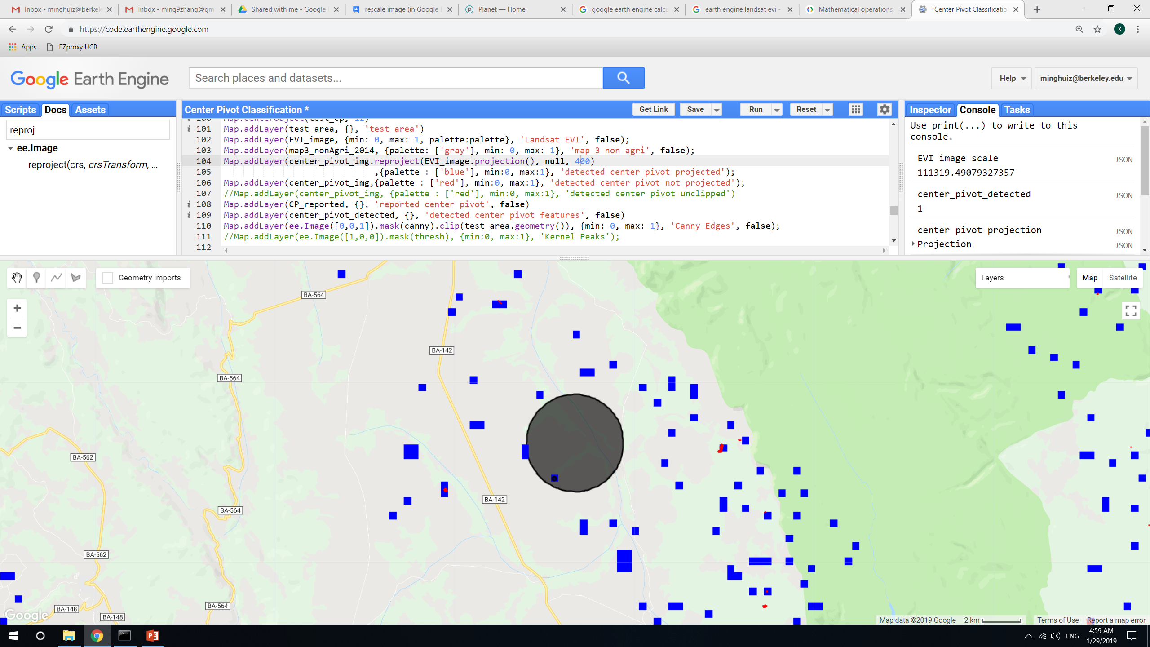
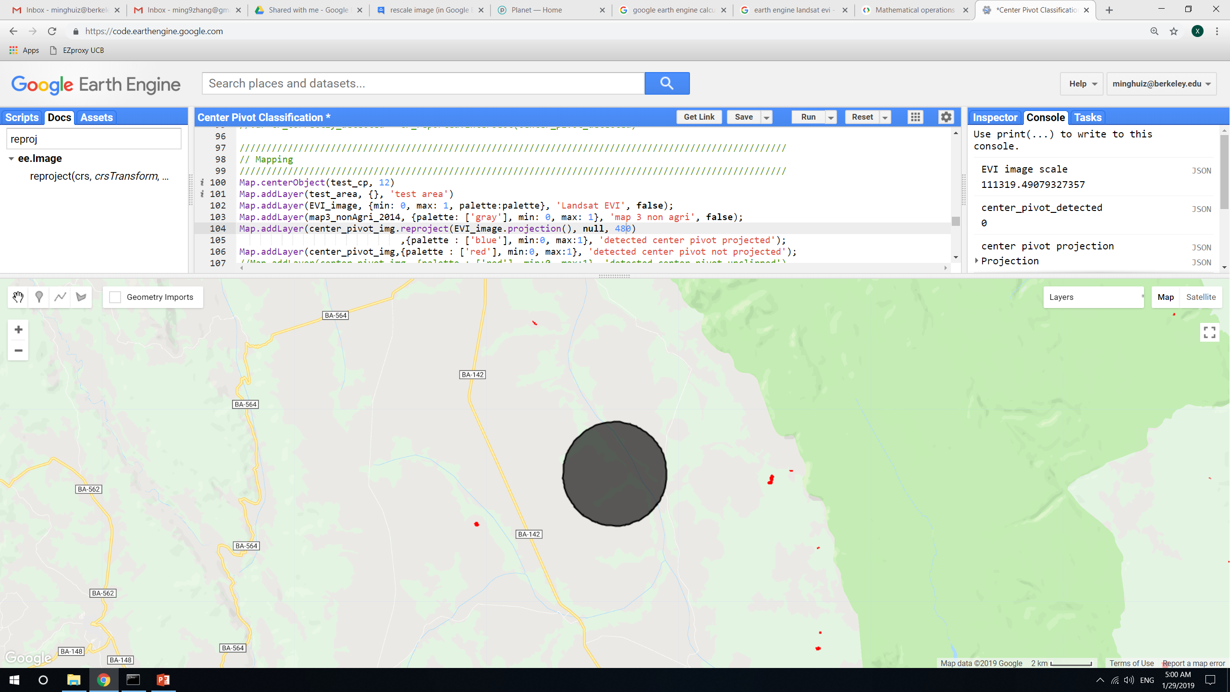
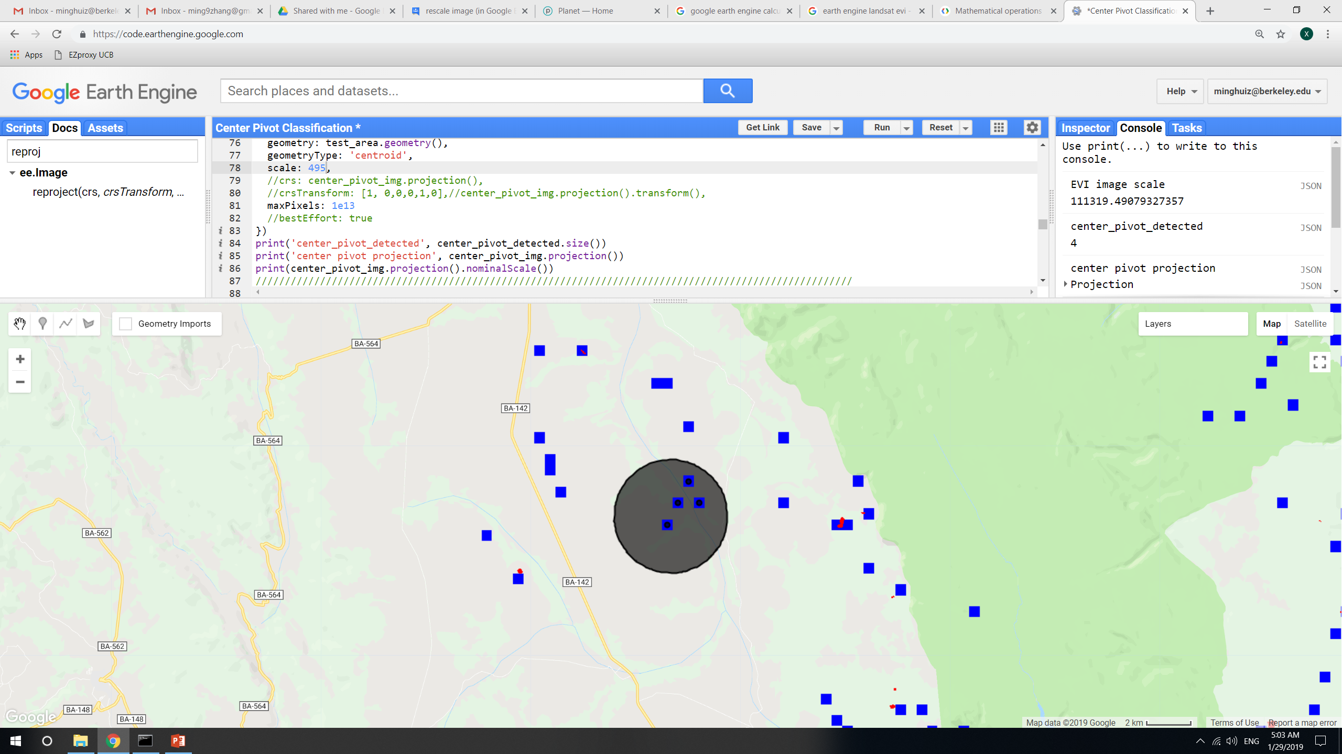
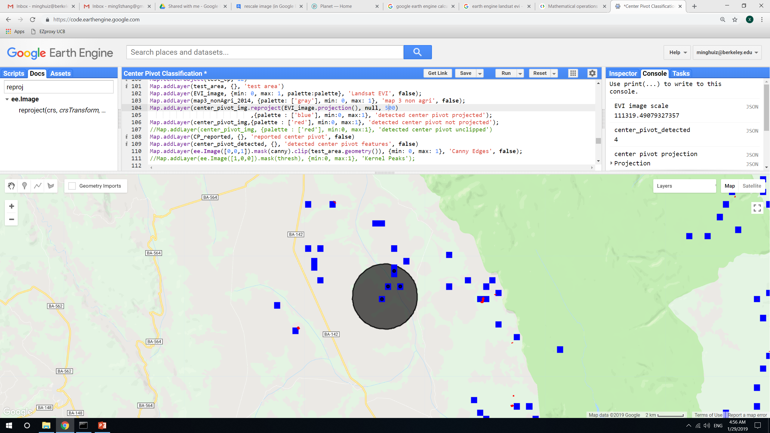
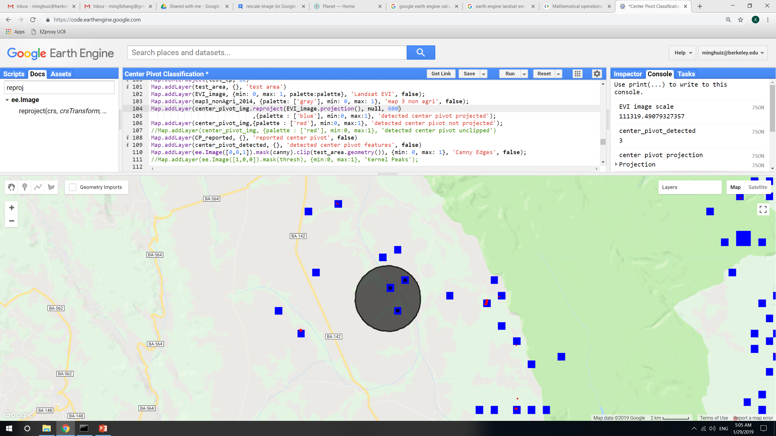
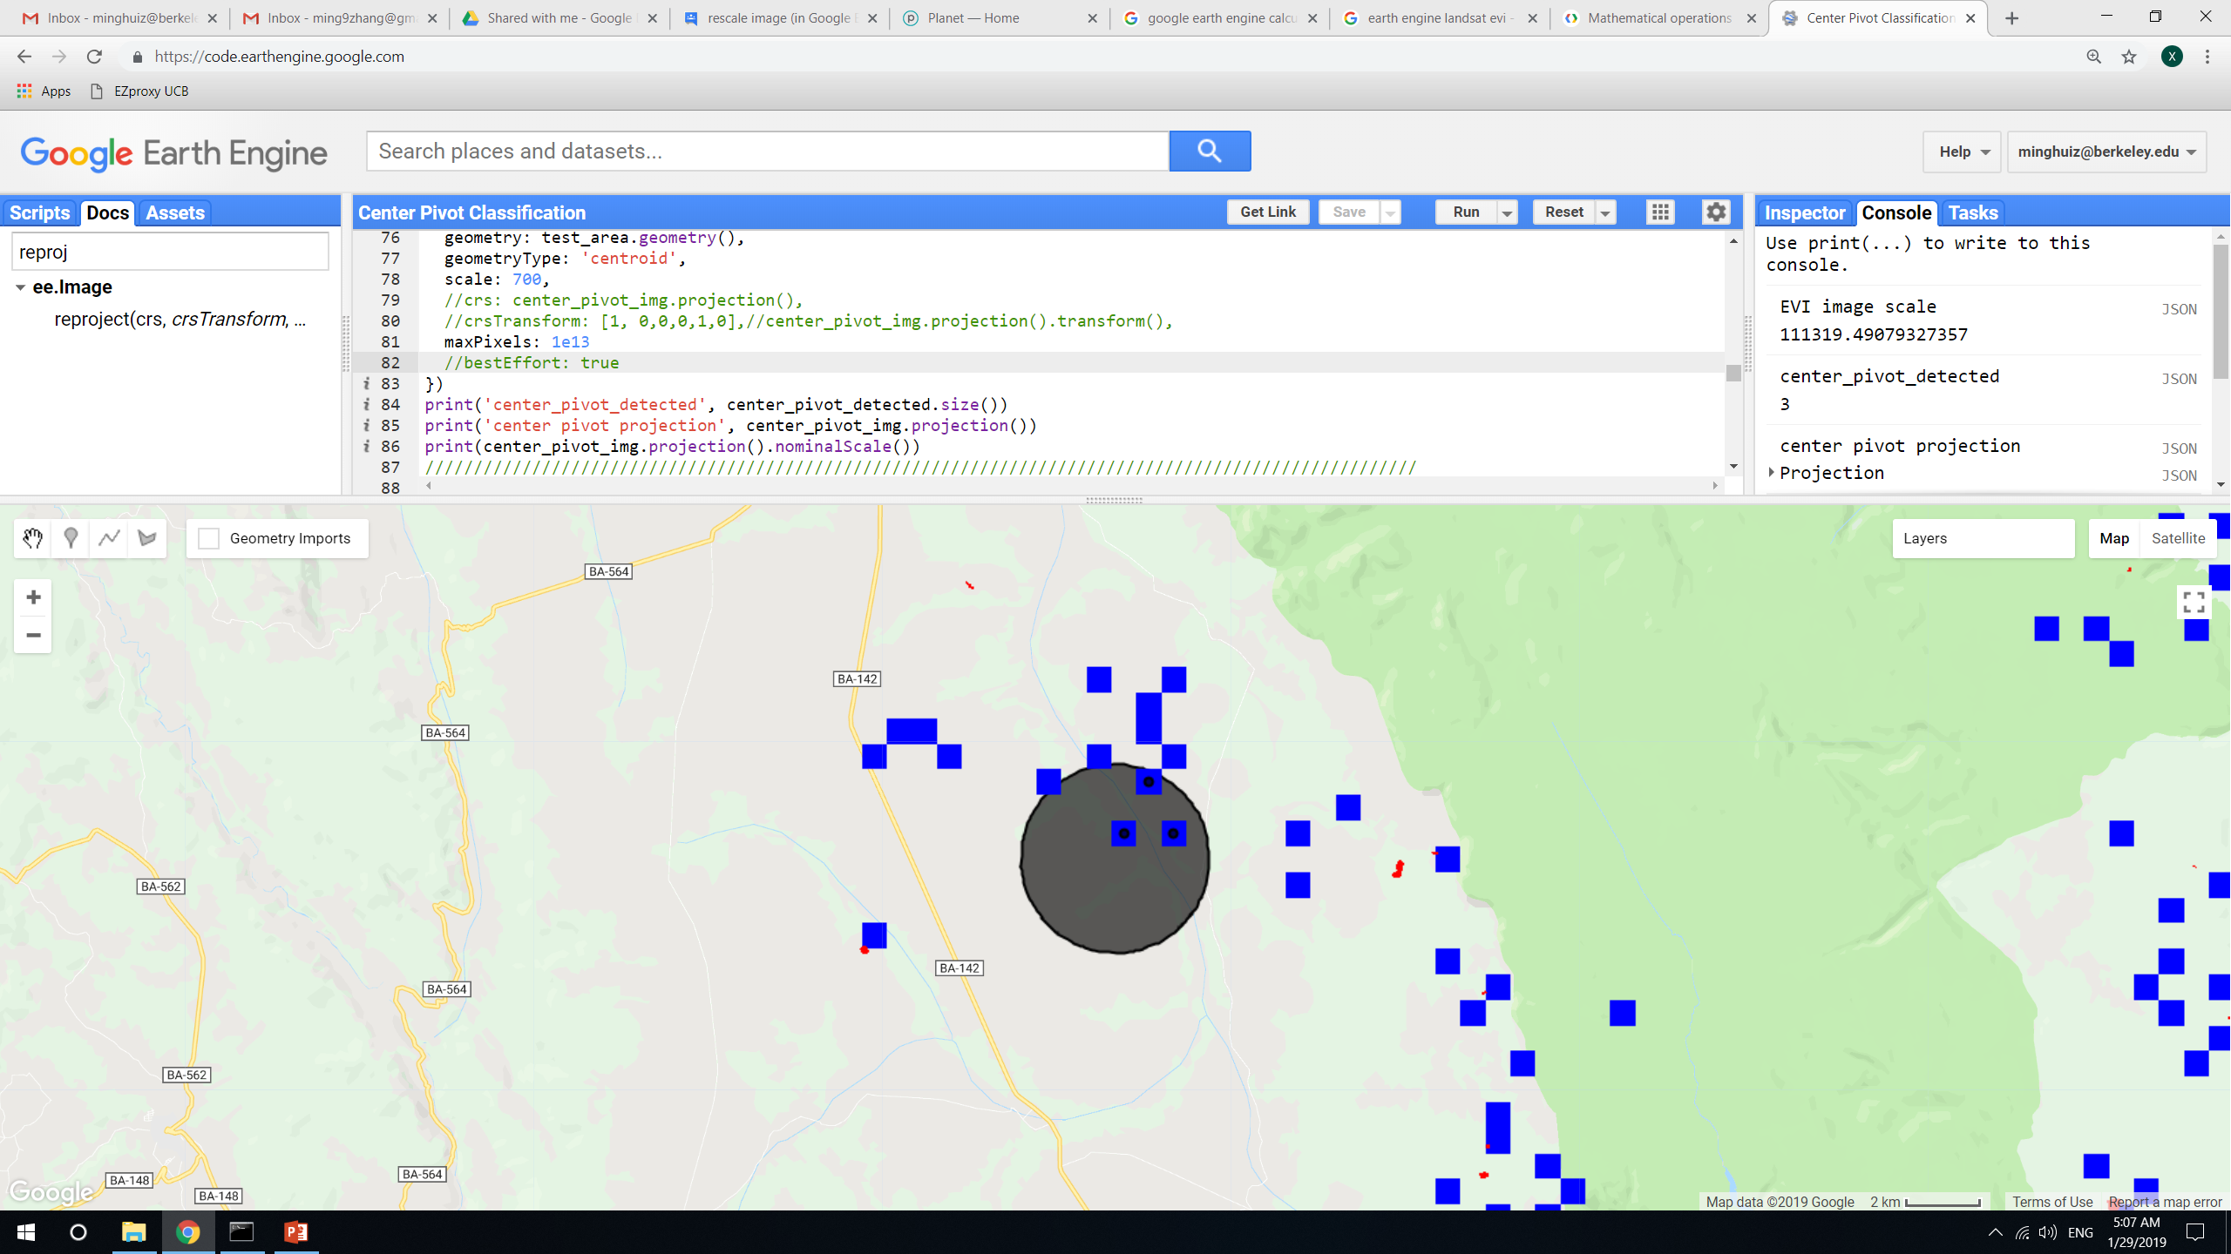
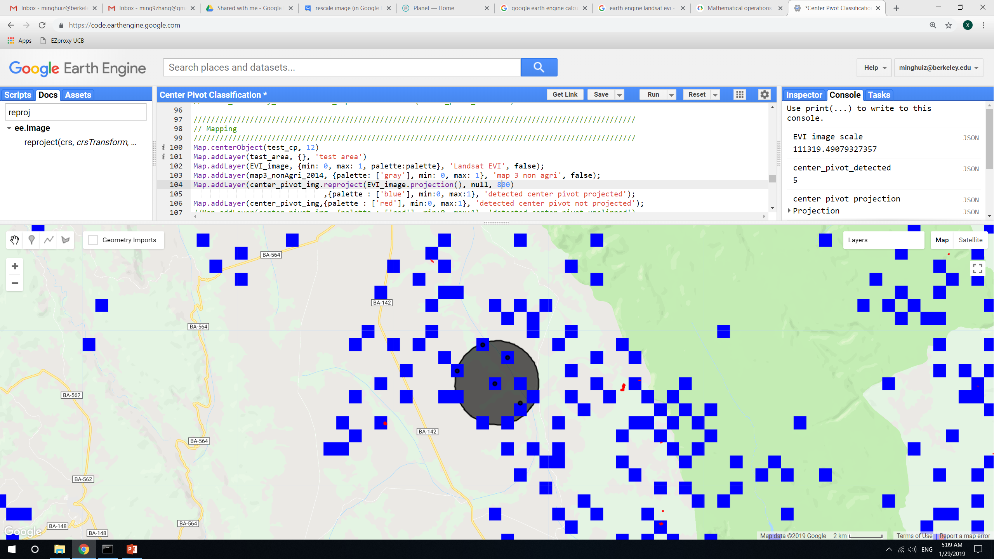
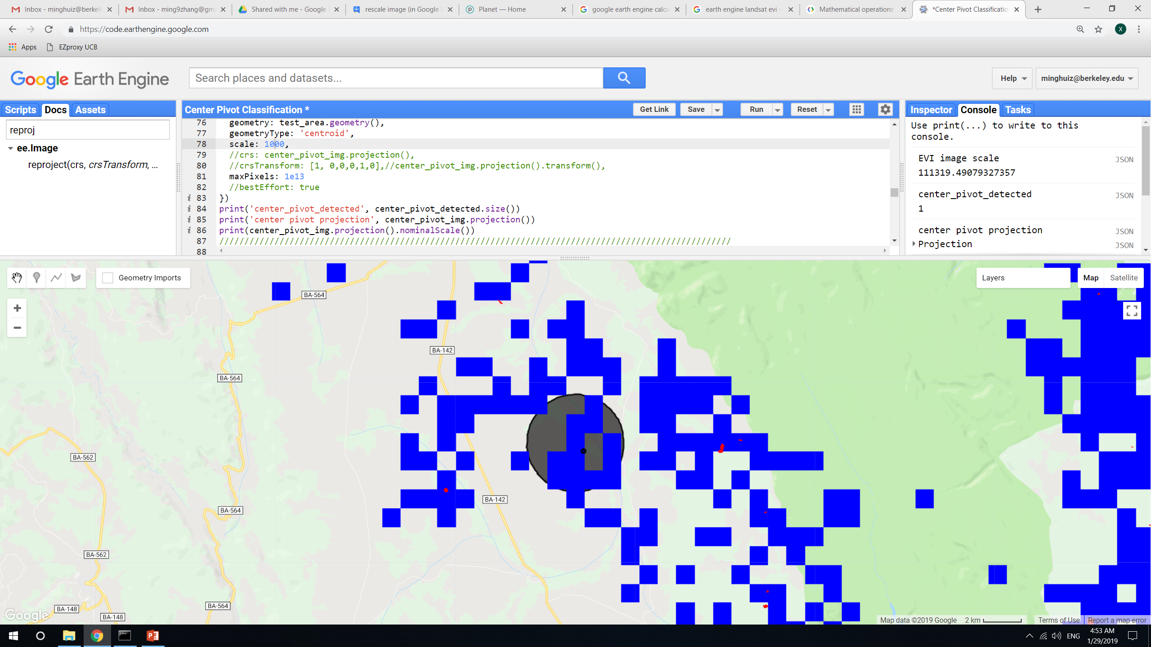
reduceToVectors() and scaling notes
reduceToVectors() and reprojection() scale = 300m
Center pivot detected in test area: 0
reduceToVectors() and reprojection() scale = 400m, 450m
Center pivot detected in test area: 1
reduceToVectors() and reprojection() scale = 480m, 490m
Center pivot detected in test area: 0
reduceToVectors() and reprojection() scale = 495m
Center pivot detected in test area: 4
reduceToVectors() and reprojection() scale = 500m
Center pivot detected in test area: 4
reduceToVectors() and reprojection() scale = 600m
Center pivot detected in test area: 3
reduceToVectors() and reprojection() scale = 1000m
Center pivot detected in test area: 1
reduceToVectors() and reprojection() scale = 700m
Center pivot detected in test area: 3
reduceToVectors() and reprojection() scale = 800m
Center pivot detected in test area: 5
In GEE: LandCover/Center Pivot Classification

Slide 8
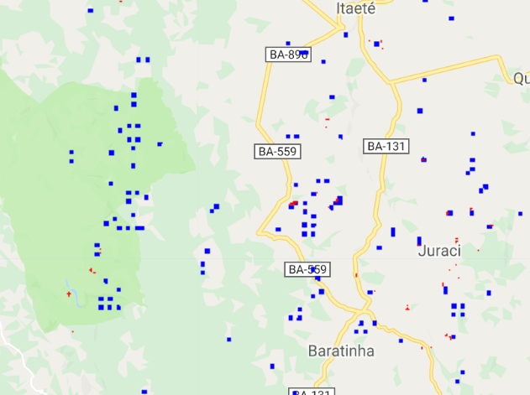
reduceToVectors() and scaling notes
Because EVI composite from Landsat is at 110m/pixel scale, try using a single landsat image at 30m/pixel scale and running center pivot detection
Unfortunately, the same problem: there are blue (reprojected) pixels where red (un reprojected) pixels don’t show up, and vice versa
In GEE: LandCover/Center Pivot Classification v2

Slide 9
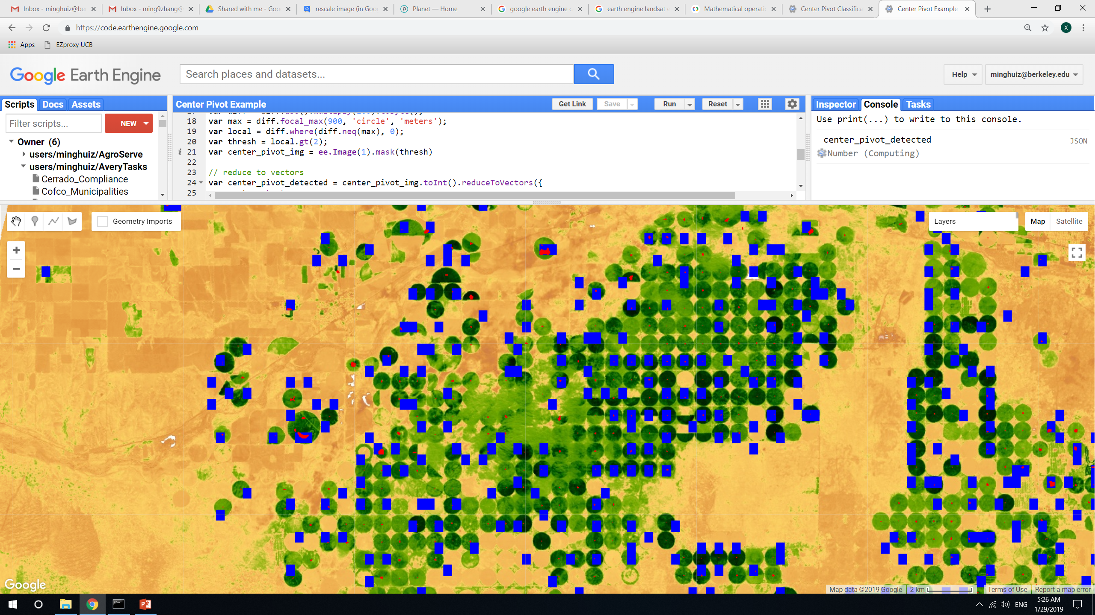
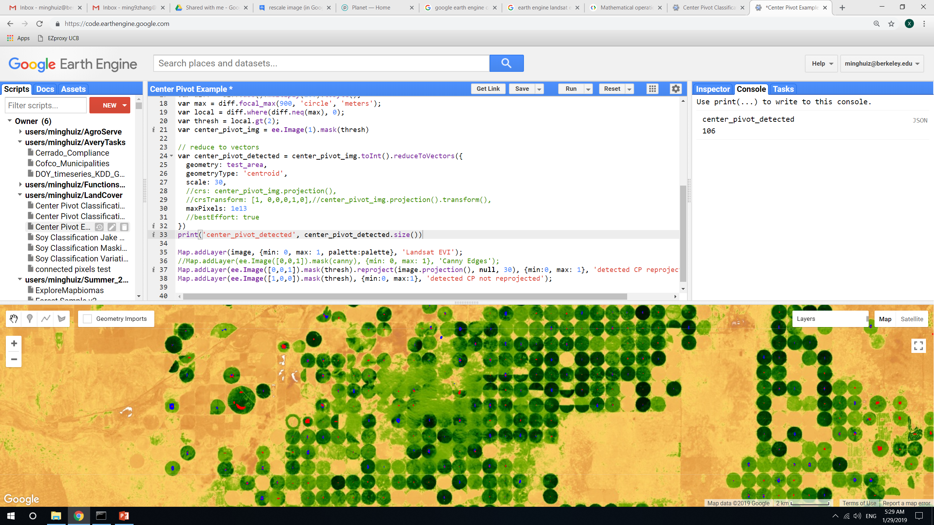
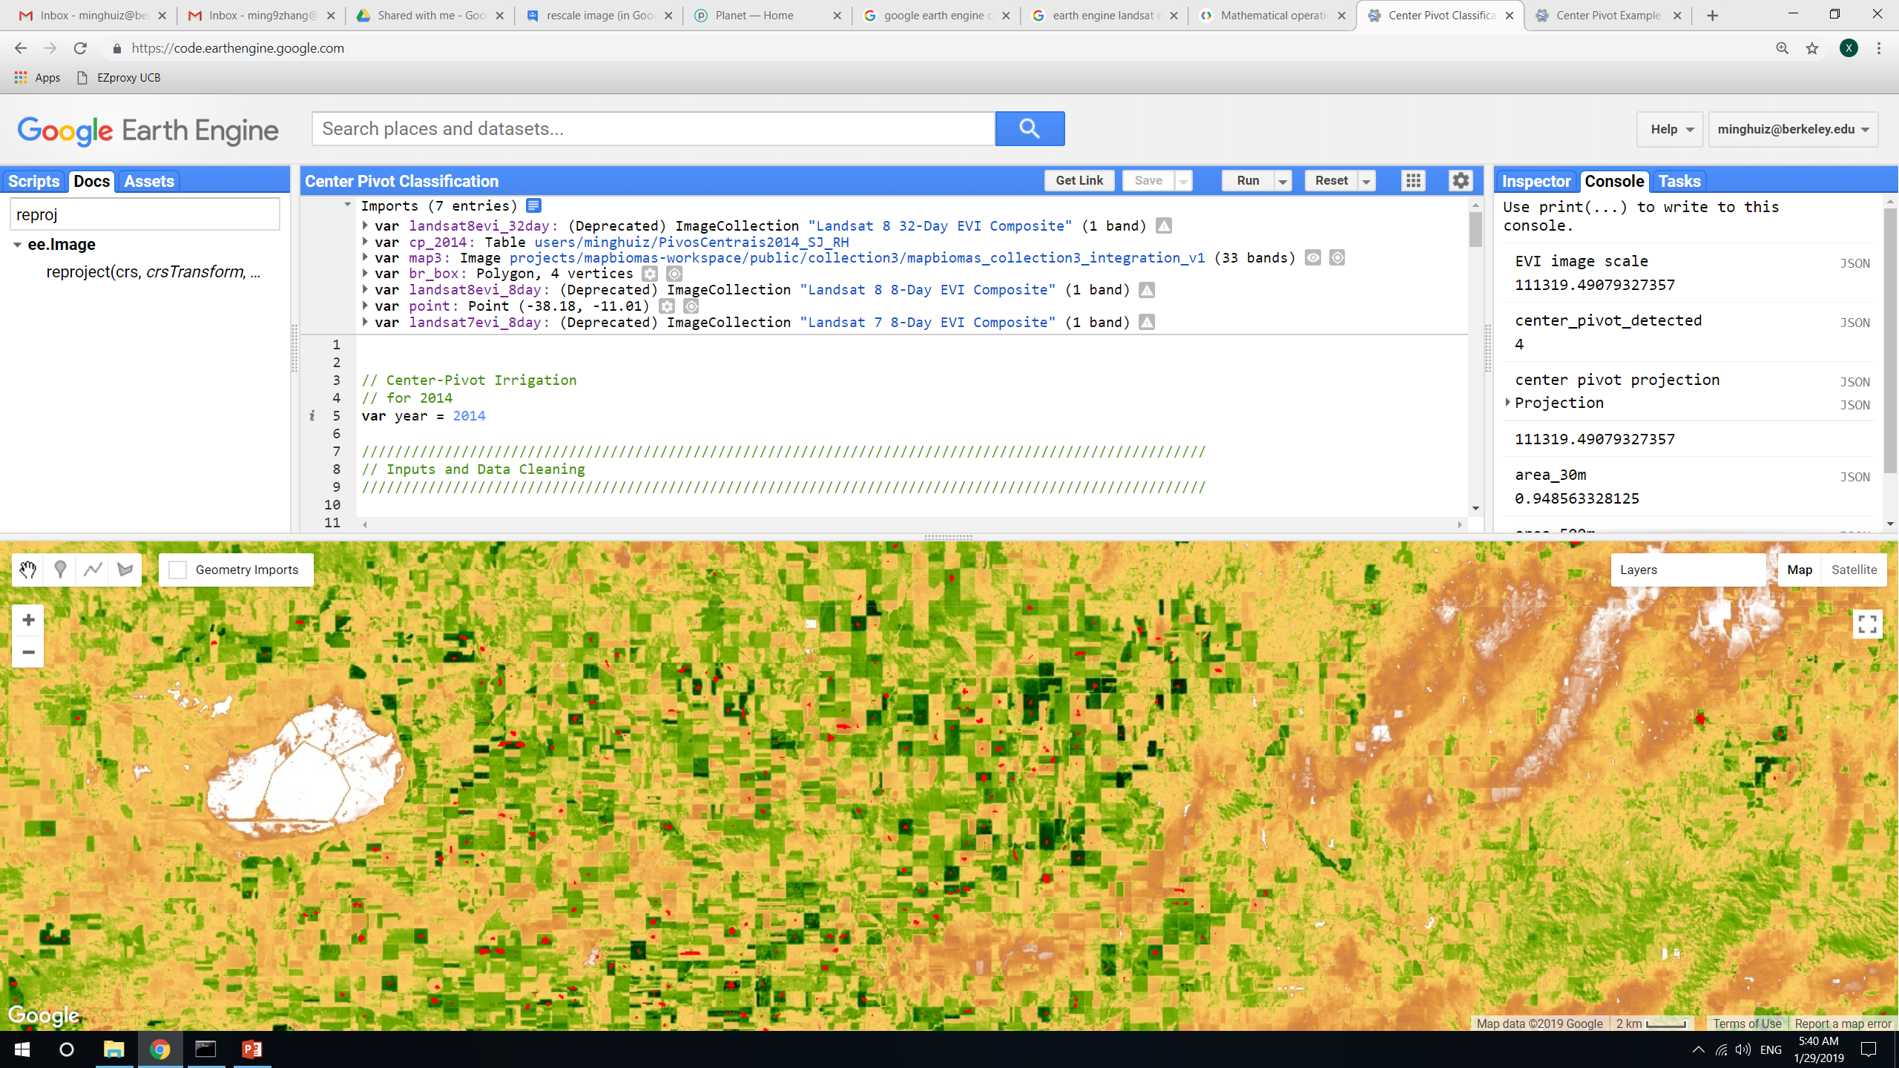
reduceToVectors() and scaling notes: for Kansas
Reprojecting to 500m scale misses a lot of detected center pivots.
Unlike over Brazil, doing reduceToVectors() at 30m scale still produces results and the blue doesn’t seem to be completely offset after reprojection()
reduceToVectors() and reprojection() scale = 500m
Center pivot detected in test area: 112
reduceToVectors() and reprojection() scale = 500m
Center pivot detected in test area: 102
Even in Kansas, heterogeneous fields are detected
In GEE: LandCover/Center Pivot Example

Slide 10
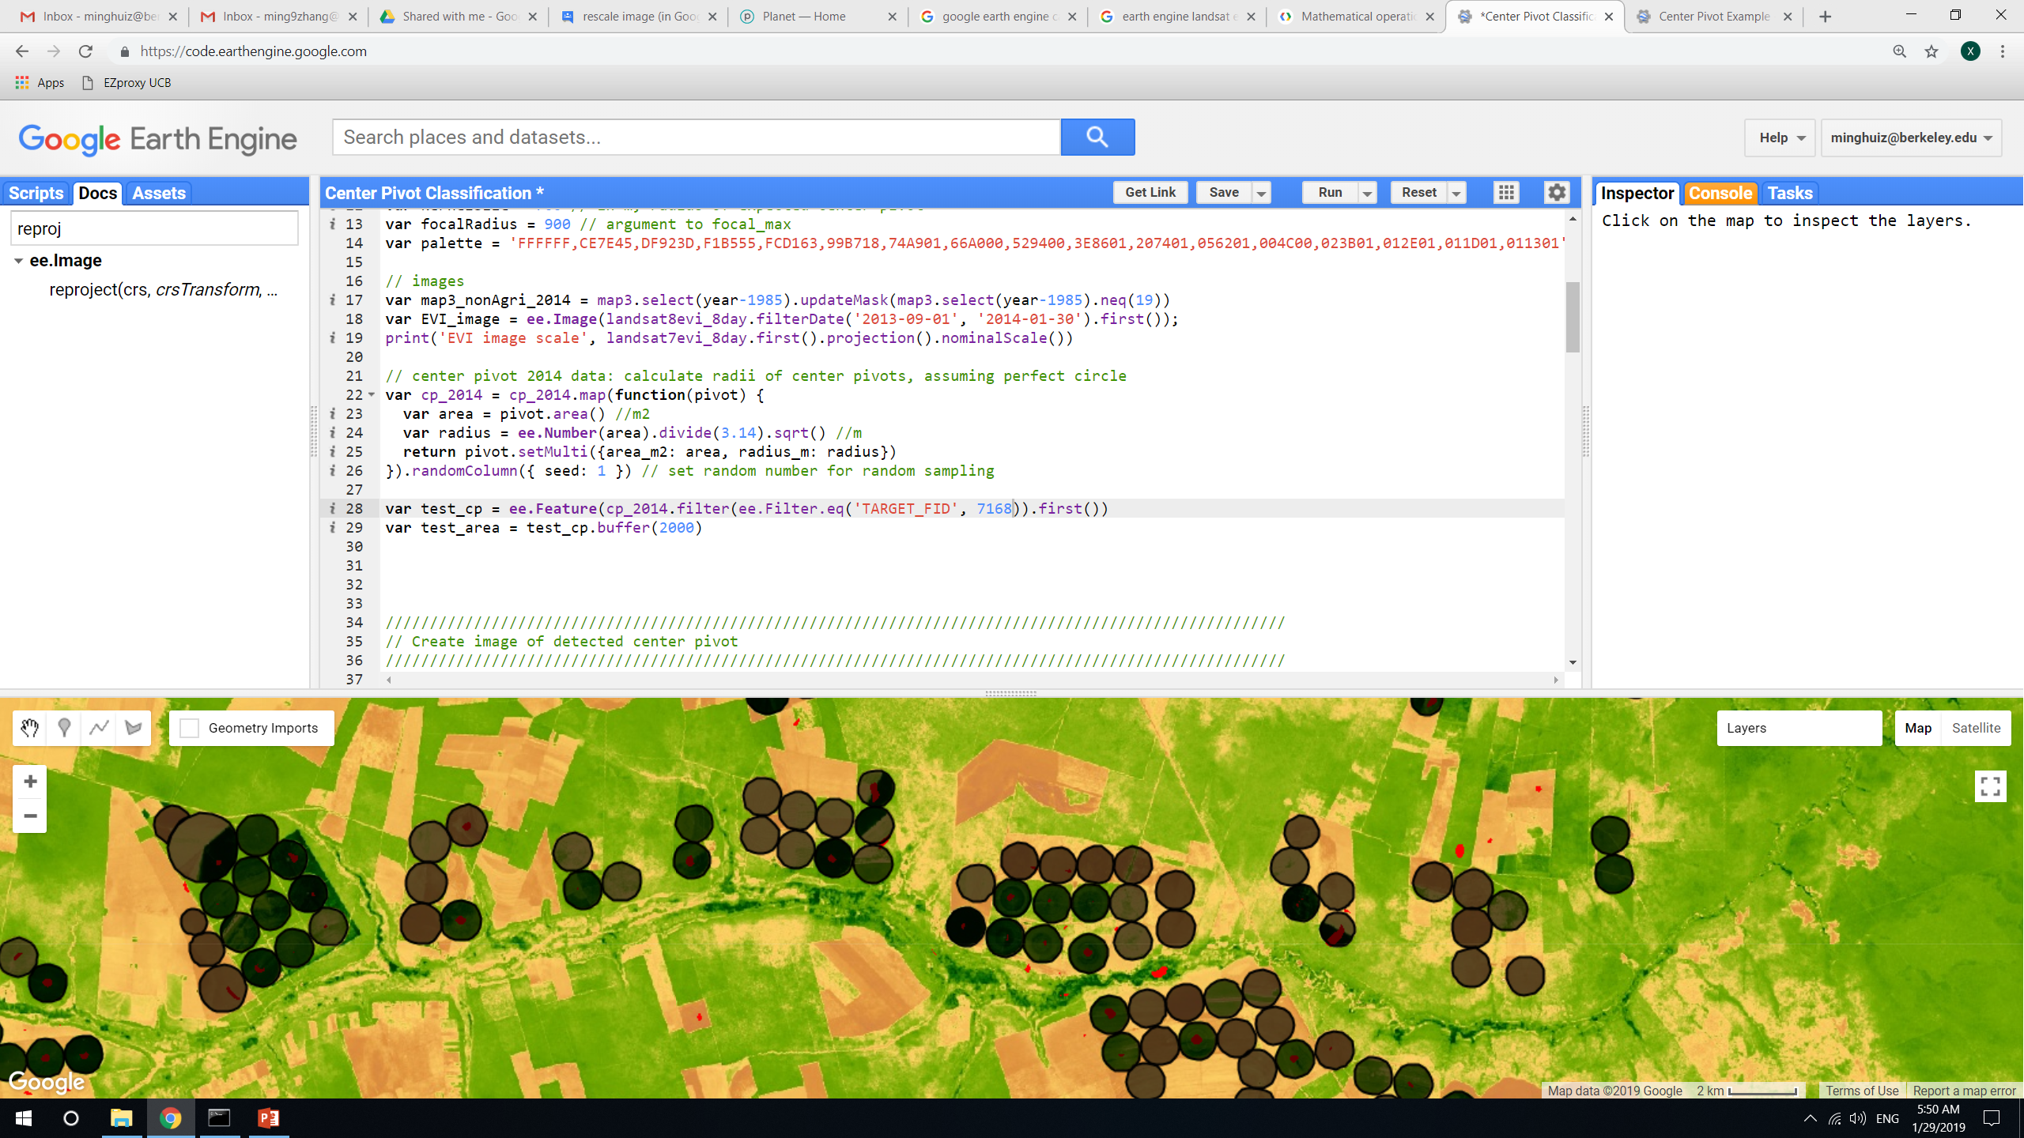
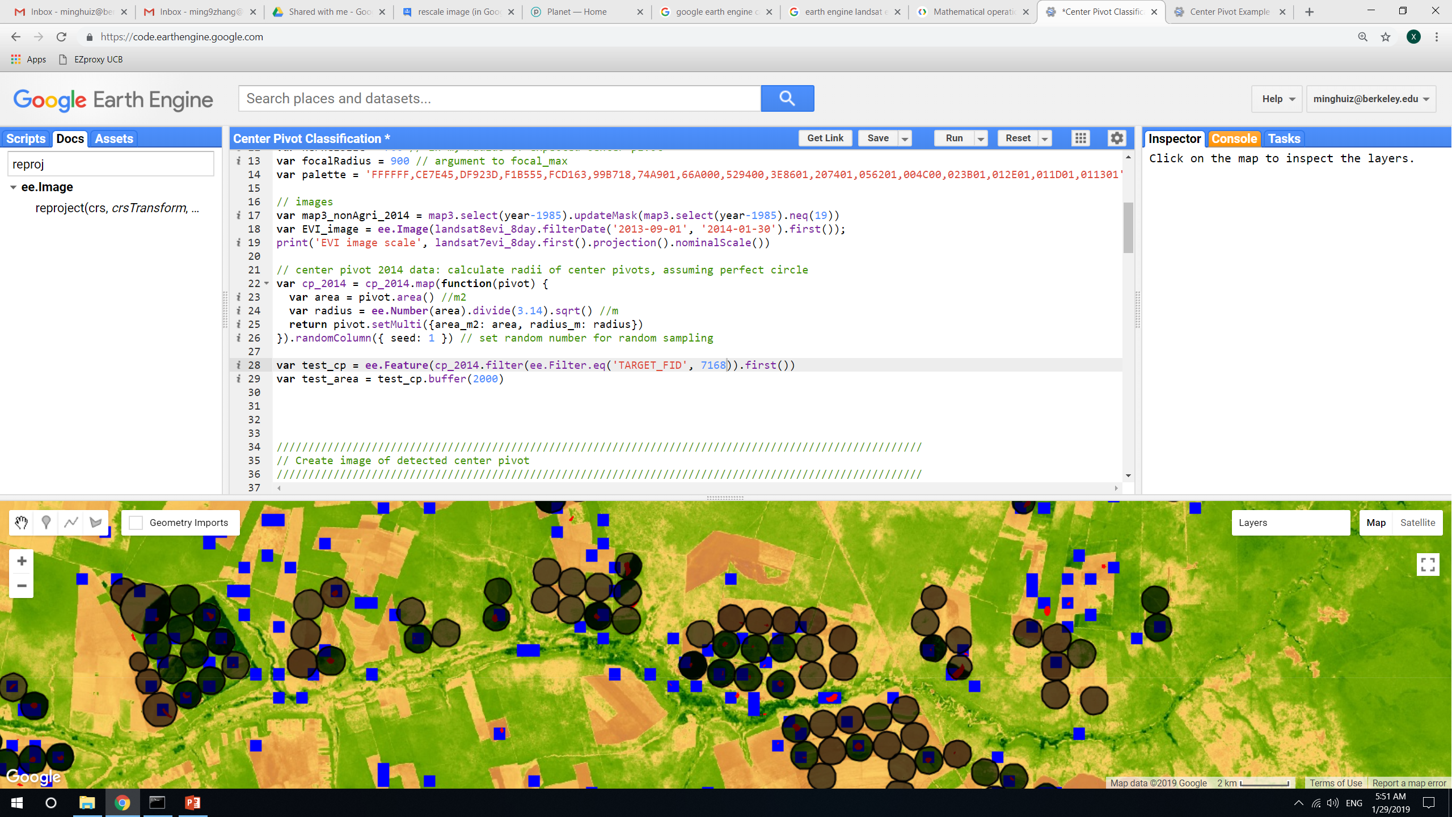
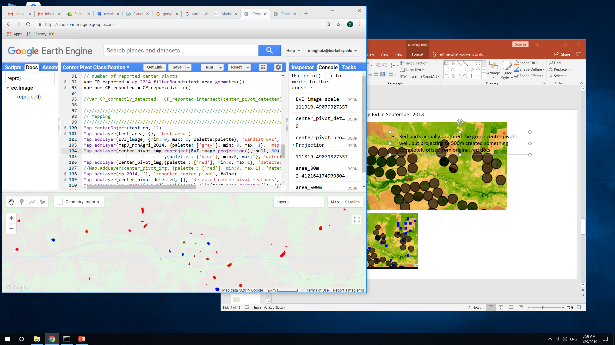
Brazil center pivot edge detection: using EVI in September 2013
Red parts actually captured the green center pivots well, but projecting to 500m created something completely offset from original red dots
When reprojecting and doing reduceToVectors at 30m, unlike before, actually got some blue (post reprojection) dots and got nine actual detected CP features – takeaway: the reduceToVectors() should be done at 30m and probably at start or end of growing season
TAKEAWAY: do reduceToVectors() analysis at 30m scale. If the area actually has obvious center pivots, reduceToVectors() and reprojection() will pick them up. Otherwise, doing reduceToVectors() at 30m will give no results, which is good.
Perhaps it ‘looked like’ red dots were showing up at zoomed out level was because neighboring areas ‘contributed’ the red dots.
Reprojected() at 500m
Reprojected() at 30m
In GEE: LandCover/Center Pivot Classification

Slide 11
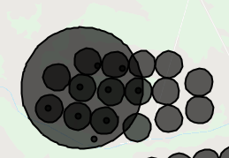
Center pivot detection: accuracy assessment at point level
Individual CPs: False positive
After masking out map3 nonagri, still detected center pivot that doesn’t overlap with reported CP.
Individual CPs: False negative
- Reported center pivot doesn’t overlap with any of the detected center pivot
 | Reported CP | Reported not CP
Detected CP | Spatial join detected features and reported features -> intersection | False positive = (detected CPs – intersection)/(reported CPs)
Detected not CP | False negative = (reported CPs – intersection)/(reported CPs) | N/A
Big circle = 2km radius test area
Small circles = reported CP
Points = detected CP
In GEE: LandCover/Center Pivot Classification

Slide 12
Center pivot detection: accuracy assessment at area level
Ultimately, will want to get rid of entire areas of CPs because don’t know what radius to associate with each detected CP centroid. Assume need to get rid of an area up to 1000m from the detected centroid.
Areas of CPs: False positive
In GEE: LandCover/Center Pivot Classification

Slide 13
Next

Slide 14
Next:
Choose center pivot detection method + produce center pivot mask
Method for taking centroid pixels and turning them into polygons of CPIS, or come up with accuracy metric that doesn’t require polygons
Plan for which images to download from Planet Labs
Temporal resolution
Location (sampled by soy area)
Cloud and view angle
QuickBird vs Planet Scope satellite
Plan for calibrating Planet Labs imagery to other satellite data

